Slide 1
Naïve Bayes Classifier
Iftekhar Mahmud Towhid

Slide 2
Naïve Bayes Classifier
Naïve Bayes algorithm is a supervised learning algorithm, which is based on Bayes theorem and used for solving classification problems.
It is mainly used in text classification that includes a high-dimensional training dataset.
Naïve Bayes Classifier is one of the simple and most effective Classification algorithms which helps in building the fast machine learning models that can make quick predictions.
It is a probabilistic classifier, which means it predicts on the basis of the probability of an object.
Some popular examples of Naïve Bayes Algorithm are spam filtration, Sentimental analysis, and classifying articles.

Slide 3
Why is it called Naïve Bayes?
The Naïve Bayes algorithm is comprised of two words Naïve and Bayes, Which can be described as:
  Naïve: It is called Naïve because it assumes that the occurrence of a certain feature is independent of the occurrence of other features. Such as if the fruit is identified on the bases of color, shape, and taste, then red, spherical, and sweet fruit is recognized as an apple. Hence each feature individually contributes to identify that it is an apple without depending on each other.
  Bayes: It is called Bayes because it depends on the principle of Bayes' Theorem.

Slide 4
Bayes' Theorem
Bayes' theorem is also known as Bayes' Rule or Bayes' law, which is used to determine the probability of a hypothesis with prior knowledge. It depends on the conditional probability.
The formula for Bayes' theorem is given as:
  P(H|E) = (P(E|H) * P(H)) / P(E)
  Where,
  P(H|E) is Posterior probability: Probability of hypothesis A on the observed event B.
  P(E|H) is Likelihood probability: Probability of the evidence given that the probability of a hypothesis is true.
  P(H) is Prior Probability: Probability of hypothesis before observing the evidence.
  P(E) is Marginal Probability: Probability of Evidence.

Slide 5
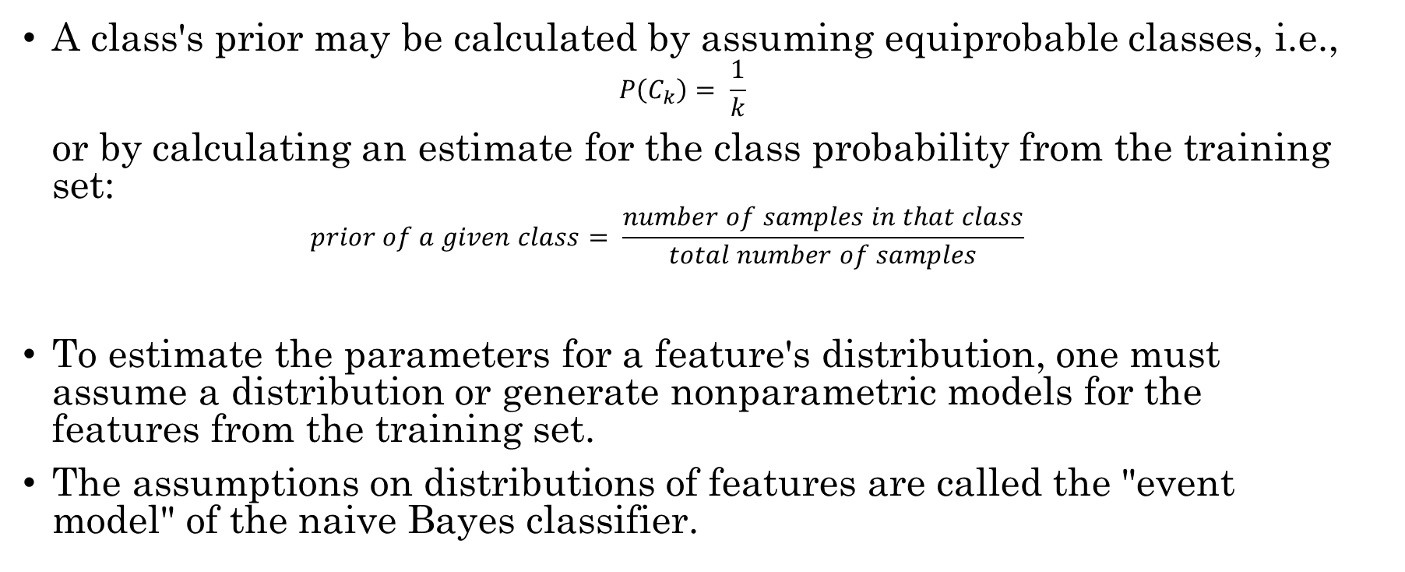
Parameter estimation and event models
A class's prior may be calculated by assuming equiprobable classes, i.e.,
$$P\left(C_{k}\right)= \frac{1}{k}$$
or by calculating an estimate for the class probability from the training set:
$$prior of a given class= \frac{number of samples in that class}{total number of samples}$$
To estimate the parameters for a feature's distribution, one must assume a distribution or generate nonparametric models for the features from the training set.
The assumptions on distributions of features are called the "event model" of the naive Bayes classifier.

Slide 6
Assumption of Naive Bayes
The fundamental Naive Bayes assumption is:
  Feature independence: The features of the data are conditionally independent of each other, given the class label.
  Continuous features are normally distributed: If a feature is continuous, then it is assumed to be normally distributed within each class.
  Discrete features have multinomial (or Bernoulli) distributions: If a feature is discrete, then it is assumed to have a multinomial distribution within each class.
  Features are equally important: All features are assumed to contribute equally to the prediction of the class label.
  No missing data: The data should not contain any missing values.

Slide 7
Assumption of Naive Bayes
With relation to our dataset, this concept can be understood as:
  We assume that no pair of features are dependent. For example, the temperature being ‘Hot’ has nothing to do with the humidity or the outlook being ‘Rainy’ has no effect on the winds. Hence, the features are assumed to be independent.
  Secondly, each feature is given the same weight(or importance). For example, knowing only temperature and humidity alone can’t predict the outcome accurately. None of the attributes is irrelevant and assumed to be contributing equally to the outcome.
The assumptions made by Naive Bayes are not generally correct in real-world situations. In-fact, the independence assumption is never correct but often works well in practice.

Slide 8
Types of Naïve Bayes Model
There are three types of Naive Bayes Model, based on the assumed distribution of the data features, which are given below:
  Gaussian: The Gaussian model assumes that features follow a normal distribution. This means if predictors take continuous values instead of discrete, then the model assumes that these values are sampled from the Gaussian distribution.
  Multinomial: The Multinomial Naïve Bayes classifier is used when the data is multinomial distributed. It is primarily used for document classification problems, it means a particular document belongs to which category such as Sports, Politics, education, etc. The classifier uses the frequency of words for the predictors.
  Bernoulli: The Bernoulli classifier works similar to the Multinomial classifier, but the predictor variables are the independent Booleans variables. Such as if a particular word is present or not in a document. This model is also famous for document classification tasks.

Slide 9
Naïve Bayes Classifier using an Example
The following table represents a fictional dataset that describes the weather conditions for playing some unspecified game.
Outlook | Temp. | Humidity | Windy | Play
sunny | hot | high | False | no
sunny | hot | high | True | no
overcast | hot | high | False | yes
rainy | mild | high | False | yes
rainy | cool | normal | False | yes
rainy | cool | normal | True | no
overcast | cool | normal | True | yes
Outlook | Temp. | Humidity | Windy | Play
sunny | hot | high | False | no
sunny | hot | high | True | no
overcast | hot | high | False | yes
rainy | mild | high | False | yes
rainy | cool | normal | False | yes
rainy | cool | normal | True | no
overcast | cool | normal | True | yes

Slide 10
Frequencies and Probabilities
Frequencies and probabilities for the weather data:
Outlook |  |  |  | Temperature |  |  |  | Humidity |  |  |  | Windy |  |  |  | Play
 | yes | no |  |  | yes | no |  |  | yes | no |  |  | yes | no |  | yes | no
sunny | 2 | 3 |  | hot | 2 | 2 |  | high | 3 | 4 |  | False | 6 | 2 |  | 9 | 5
overcast | 4 | 0 |  | mild | 4 | 2 |  | normal | 6 | 1 |  | True | 3 | 3
rainy | 3 | 2 |  | cool | 3 | 1
 | yes | no |  |  | yes | No |  |  | yes | no |  |  | yes | no |  | yes | no
sunny | 2/9 | 3/5 |  | hot | 2/9 | 2/5 |  | high | 3/9 | 4/5 |  | False | 6/9 | 2/5 |  | 9/14 | 5/14
overcast | 4/0 | 0/5 |  | mild | 4/9 | 2/5 |  | normal | 6/9 | 1/5 |  | True | 3/9 | 3/5
rainy | 3/9 | 2/5 |  | cool | 3/9 | 1/5

Slide 11
Classifying an Unseen Example
Now assume that we have to classify the following new instance:
Outlook | Temp. | Humidity | Windy | Play
sunny | cool | high | true | ?
Calculate posterior probability
P(Play = yes | outlook == sunny ^ temp = cool….)
P(Play = no | outlook == sunny ^ temp = cool….)

Slide 12
Simple approach
Key idea: Compute a probability for each class based on the probability distribution in the training data.
First consider the probability of each attribute. Treat all attributes equally important, i.e., multiply the probabilities:
    P(yes) = 2/9 • 3/9 • 3/9 • 3/9 = 0.0082
    P(no) = 3/5 • 1/5 • 4/5 • 3/5 = 0.0577
Now consider the overall probability of a given class. Multiply it with the probabilities of the attributes:
    P(yes) = 0.0082 • 9/14 = 0.0053
    P(no) = 0.0577 • 5/14 = 0.0206
Now choose the class so that it maximizes this probability. This means that the new instance will be classified as no.

Slide 13
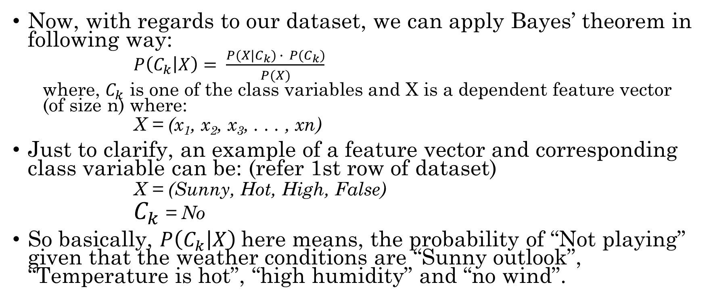
Bayesian approach
Now, with regards to our dataset, we can apply Bayes’ theorem in following way:
  $P\left(C_{k} | X\right)= \frac{P(X|C_{k}) ∙ P(C_{k})}{P(X)}$
  where, $C_{k}$ is one of the class variables and X is a dependent feature vector (of size n) where:
  $\text{X}\text{ = (}\text{x}\text{1}\text{, }\text{x}\text{2}\text{, }\text{x}\text{3}\text{, . . . , }\text{xn}\text{)}$
Just to clarify, an example of a feature vector and corresponding class variable can be: (refer 1st row of dataset)
    X = (Sunny, Hot, High, False)
    $C_{k}$ = No
So basically, $P\left(C_{k} | X\right)$here means, the probability of “Not playing” given that the weather conditions are “Sunny outlook”, “Temperature is hot”, “high humidity” and “no wind”.

Slide 14
Cont.
With relation to our dataset, this concept can be understood as:
  We assume that no pair of features are dependent. For example, the temperature being ‘Hot’ has nothing to do with the humidity or the outlook being ‘Rainy’ has no effect on the winds. Hence, the features are assumed to be independent.
  Secondly, each feature is given the same weight(or importance). For example, knowing only temperature and humidity alone can’t predict the outcome accurately. None of the attributes is irrelevant and assumed to be contributing equally to the outcome.

Slide 15
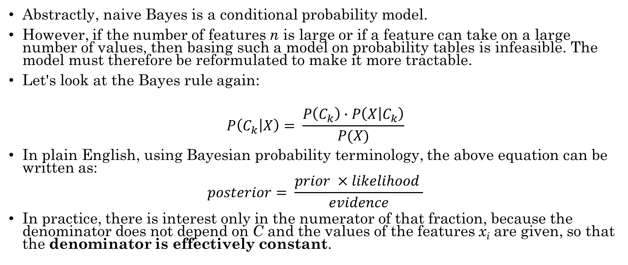
Formulating the classifier
Abstractly, naive Bayes is a conditional probability model.
However, if the number of features n is large or if a feature can take on a large number of values, then basing such a model on probability tables is infeasible. The model must therefore be reformulated to make it more tractable.
Let's look at the Bayes rule again:
$$P\left(C_{k} | X\right)= \frac{P\left(C_{k}\right)∙P\left(X | C_{k}\right)}{P(X)}$$
In plain English, using Bayesian probability terminology, the above equation can be written as:
$$posterior= \frac{prior ×likelihood }{evidence}$$
In practice, there is interest only in the numerator of that fraction, because the denominator does not depend on C and the values of the features x_{i} are given, so that the denominator is effectively constant.

Slide 16
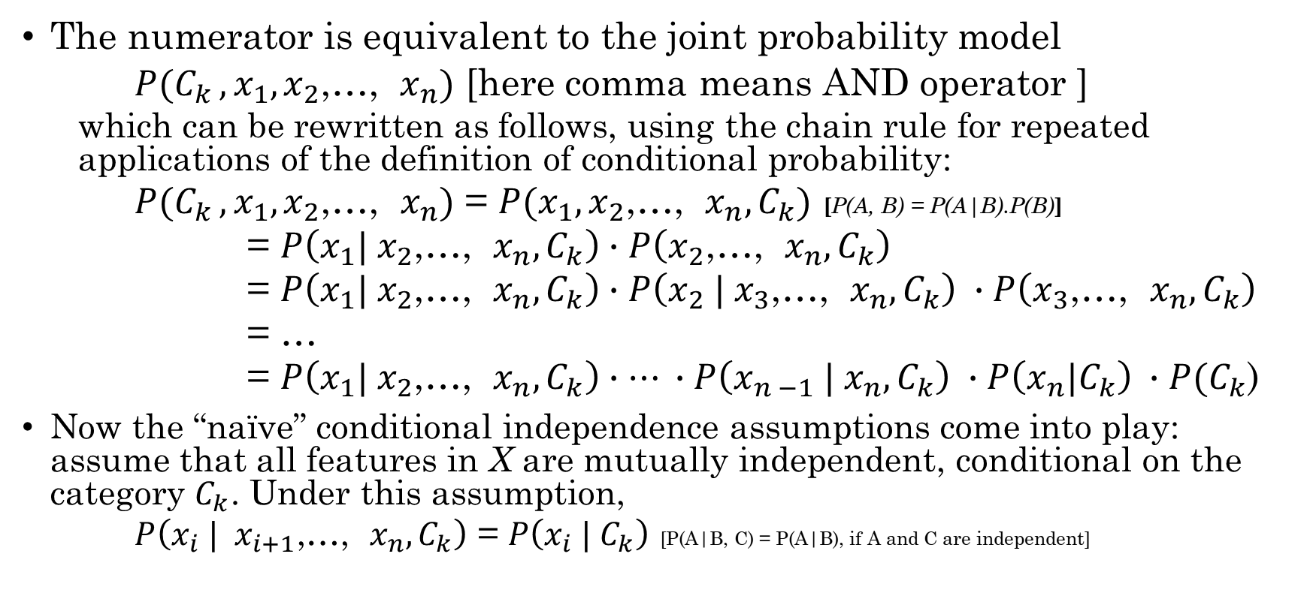
Formulating the classifier (cont.)
The numerator is equivalent to the joint probability model
  $P(C_{k }, x_{1},x_{2}$,…, $x_{n})$ [here comma means AND operator ]
  which can be rewritten as follows, using the chain rule for repeated applications of the definition of conditional probability:
  $P(C_{k }, x_{1},x_{2}\text{,…, }x_{n})$ = $P(x_{1},x_{2}\text{,…, }x_{n},C_{k})$ [P(A, B) = P(A|B).P(B)]
  = $P\left(x_{1}| x_{2}\text{,…, }x_{n},C_{k}\right)∙P\left(x_{2}\text{,…, }x_{n},C_{k}\right)$
  = $P\left(x_{1}| x_{2}\text{,…, }x_{n},C_{k}\right)∙P\left(x_{2}\text{ |}{ x}_{3}\text{,…, }x_{n},C_{k}\right) ∙P\left(x_{3}\text{,…, }x_{n},C_{k}\right)$
  = …
  = $P\left(x_{1}| x_{2}\text{,…, }x_{n},C_{k}\right)∙… ∙P\left(x_{n −1}\text{ |} x_{n},C_{k}\right) ∙P\left(x_{n}|C_{k}\right) ∙P(C_{k}$)
Now the “naïve” conditional independence assumptions come into play: assume that all features in X are mutually independent, conditional on the category $C_{k}$. Under this assumption,
    $P\left(x_{i} | x_{i+1}\text{,…, }x_{n},C_{k}\right)$ = $P\left(x_{i} | C_{k}\right)$ [P(A|B, C) = P(A|B), if A and C are independent]

Slide 17
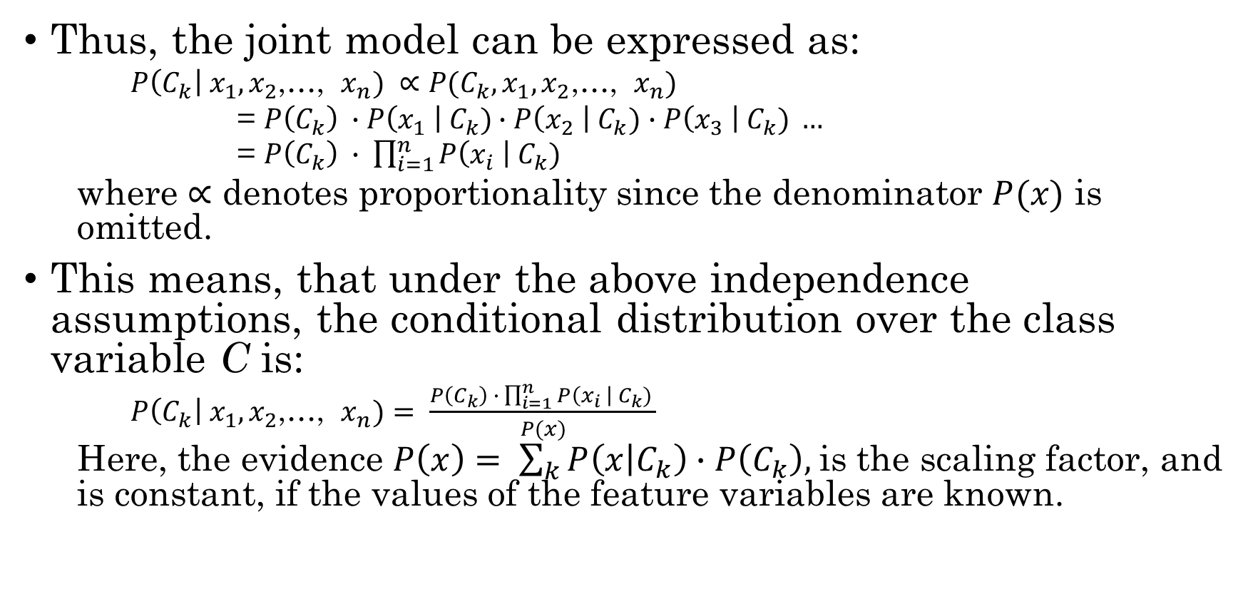
Formulating the classifier (cont.)
Thus, the joint model can be expressed as:
    $P\left(C_{k}\right| x_{1},x_{2}$,…, $x_{n}) ∝P(C_{k}, x_{1},x_{2}\text{,…, }x_{n})$
    = $P\left(C_{k}\right) ∙P\left(x_{1} \right| C_{k})∙P\left(x_{2} \right| C_{k})$ $∙P\left(x_{3} \right| C_{k}) …$
    = $P\left(C_{k}\right) ∙ \prod_{i=1}^{n}{P\left(x_{i} \right| C_{k}) }$
  where ∝ denotes proportionality since the denominator $P(x)$ is omitted.
This means, that under the above independence assumptions, the conditional distribution over the class variable C is:
    $P\left(C_{k}\right| x_{1},x_{2}$,…, $x_{n})= \frac{P\left(C_{k}\right) ∙ \prod_{i=1}^{n}{P\left(x_{i} \right| C_{k}) }}{P(x)}$
  Here, the evidence $P\left(x\right)= \sum_{k}{P\left(x | C_{k}\right)∙P\left(C_{k}\right), }$is the scaling factor, and is constant, if the values of the feature variables are known.

Slide 18
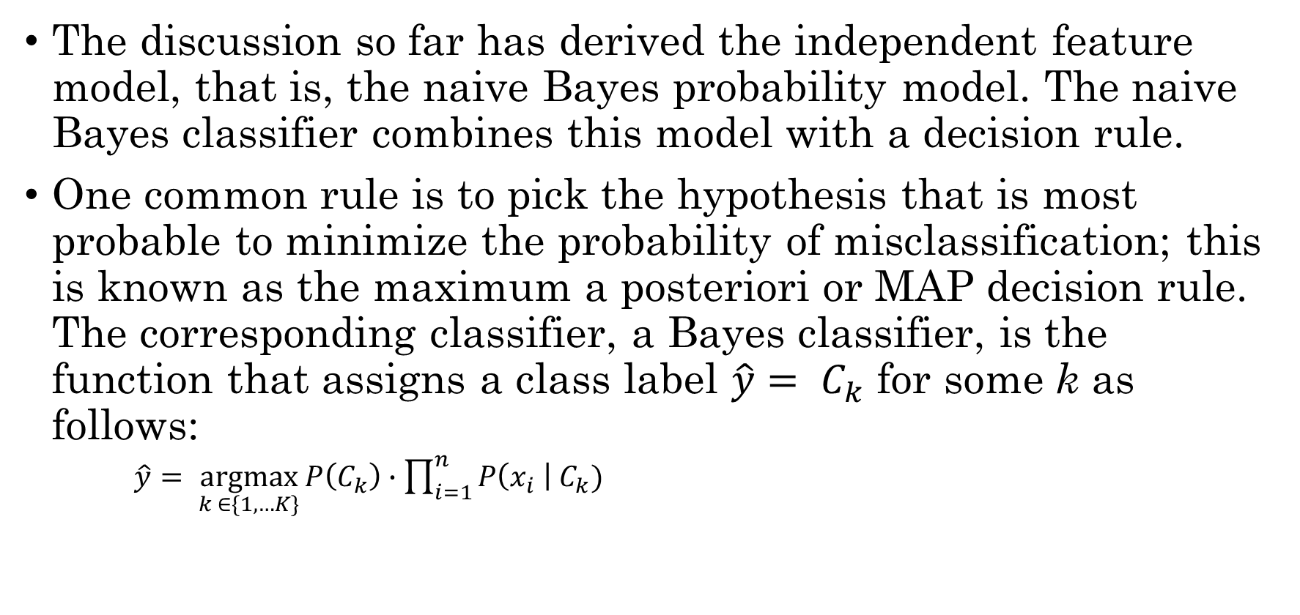
Constructing a classifier from the probability model
The discussion so far has derived the independent feature model, that is, the naive Bayes probability model. The naive Bayes classifier combines this model with a decision rule.
One common rule is to pick the hypothesis that is most probable to minimize the probability of misclassification; this is known as the maximum a posteriori or MAP decision rule. The corresponding classifier, a Bayes classifier, is the function that assigns a class label $\hat{y}= C_{k}$ for some k as follows:
    $\hat{y}= \underset{k ∈\{1, …K\}}{argmax}{P\left(C_{k}\right)∙\prod_{i=1}^{n}{P\left(x_{i} \right| C_{k}) }}$

Slide 19
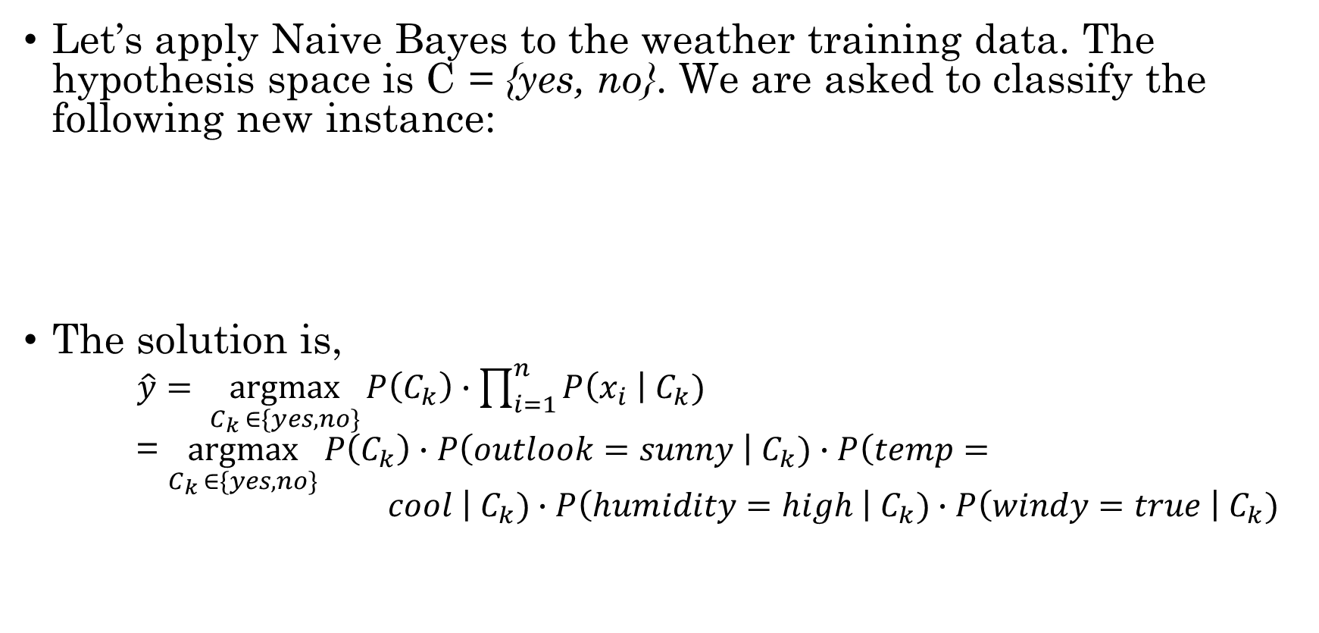
Solving the problem using Naïve Bayes
Let’s apply Naive Bayes to the weather training data. The hypothesis space is C = {yes, no}. We are asked to classify the following new instance:
The solution is,
  $\hat{y}= \underset{C_{k} ∈\{yes, no\}}{argmax}{P\left(C_{k}\right)∙\prod_{i=1}^{n}{P\left(x_{i} \right| C_{k}) }}$
  = $\underset{C_{k} ∈\{yes, no\}}{argmax}{P\left(C_{k}\right)∙P\left(outlook=sunny \right| C_{k})∙P\left(temp= cool \right| C_{k})∙P\left(humidity=high \right| C_{k})∙P\left(windy=true \right| C_{k})}$
Outlook | Temp. | Humidity | Windy | Play
sunny | cool | high | true | ?
Notes:
temp

Slide 20
Solving the problem using Naïve Bayes
We can simply plug in the values and find the class for which the posterior is maximum.
Compute priors:
  P(play = yes) = 9/14
  P(play = no) = 5/14
Compute conditionals (examples):
  P(windy = true | play = yes) = 3/9
  P(windy = true | play = no) = 3/5
Then compute the best class:
P(yes) ⋅ P(sunny|yes) ⋅ P(cool|yes) ⋅ P(high|yes) ⋅ P(true|yes)
= 9/14 ⋅ 2/9 ⋅ 3/9 ⋅ 3/9 ⋅ 3/9 = 00053
P(no) ⋅ P(sunny| no) ⋅ P(cool| no) ⋅ P(high| no) ⋅ P(true| no)
= 5/14 ⋅ 3/5 ⋅ 1/5 ⋅ 4/5 ⋅ 3/5 = 00206
Thus, we can see for play = no, the posterior is maximized.

Slide 21
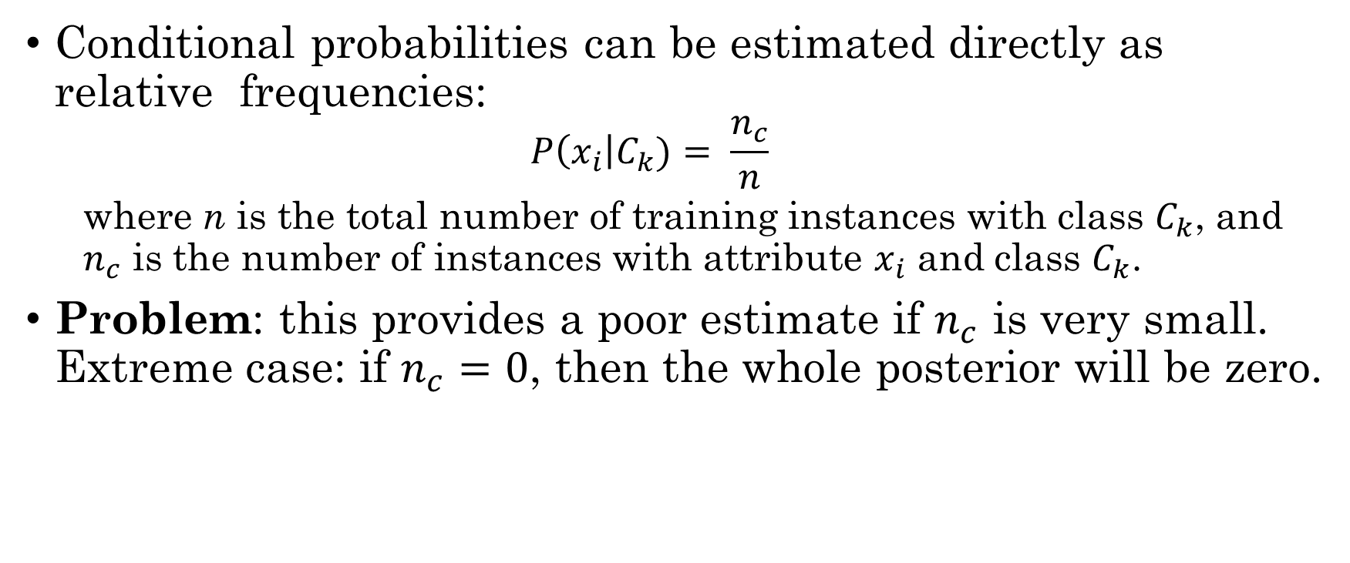
Naive Bayes: Problem with Sparse Data
Conditional probabilities can be estimated directly as relative frequencies:
  $$P\left(x_{i}\right|C_{k})= \frac{n_{c}}{n}$$
  where n is the total number of training instances with class $C_{k}$, and $n_{c}$ is the number of instances with attribute $x_{i}$ and class $C_{k}$.
Problem: this provides a poor estimate if $n_{c}$ is very small. Extreme case: if $n_{c}=0$, then the whole posterior will be zero.

Slide 22
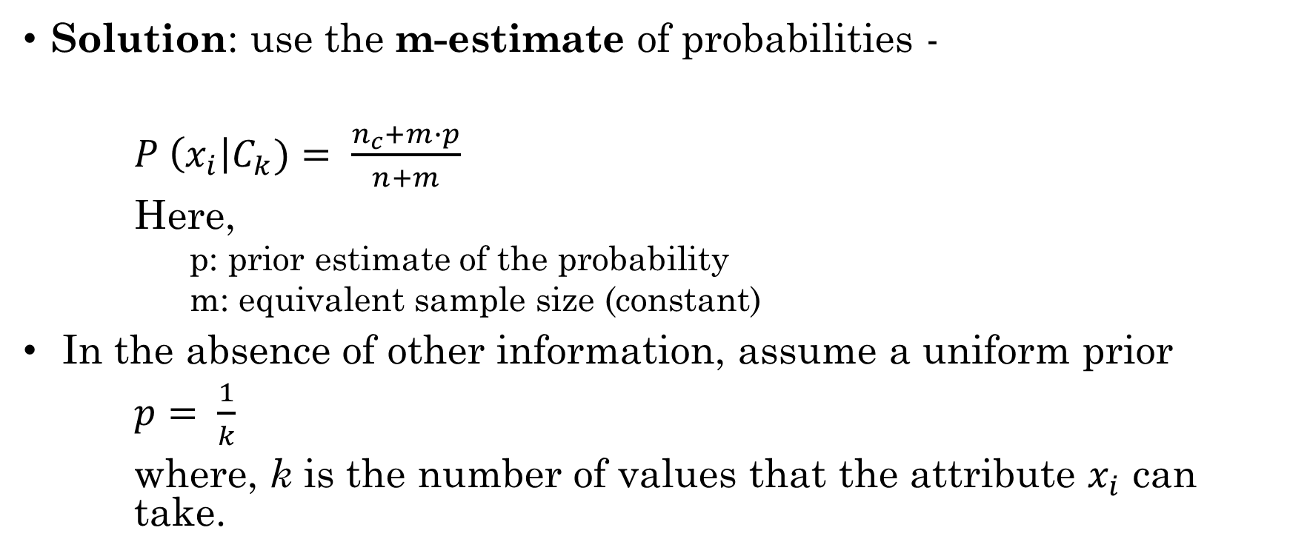
Naive Bayes: Problem with Sparse Data
Solution: use the m-estimate of probabilities -
$P \left(x_{i}\right|C_{k})= \frac{n_{c}+m∙p}{n+m}$
Here,
      p: prior estimate of the probability
      m: equivalent sample size (constant)
In the absence of other information, assume a uniform prior
$p= \frac{1}{k}$
where, k is the number of values that the attribute $x_{i}$ can take.

Slide 23
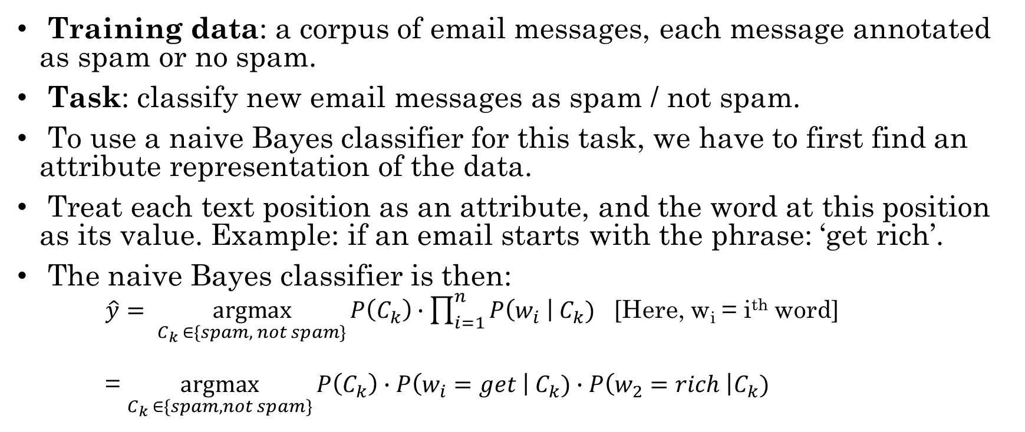
Practical example: Spam detection
Training data: a corpus of email messages, each message annotated as spam or no spam.
Task: classify new email messages as spam / not spam.
To use a naive Bayes classifier for this task, we have to first find an attribute representation of the data.
Treat each text position as an attribute, and the word at this position as its value. Example: if an email starts with the phrase: ‘get rich’.
The naive Bayes classifier is then:
  $\hat{y}= \underset{C_{k} ∈\{spam, not spam\}}{argmax}{P\left(C_{k}\right)∙\prod_{i=1}^{n}{P\left(w_{i} \right| C_{k}) }}$ [Here, w_{i} = i^{th} word]
  = $\underset{C_{k} ∈\{spam, not spam\}}{argmax}{P\left(C_{k}\right)∙P\left(w_{i}=get \right| C_{k})∙P\left(w_{2}=rich \right|C_{k})}$

Slide 24
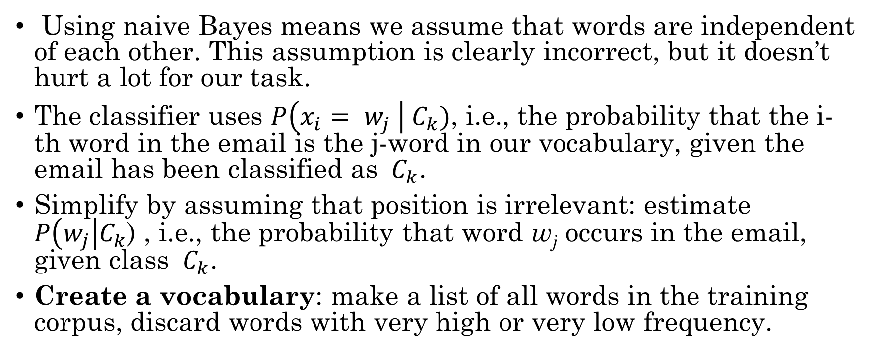
Practical example: Spam detection
Using naive Bayes means we assume that words are independent of each other. This assumption is clearly incorrect, but it doesn’t hurt a lot for our task.
The classifier uses $P\left(x_{i}= w_{j} \right|{ C}_{k})$, i.e., the probability that the i-th word in the email is the j-word in our vocabulary, given the email has been classified as ${ C}_{k}$.
Simplify by assuming that position is irrelevant: estimate $P\left(w_{j}\right|C_{k}$) , i.e., the probability that word w_{j} occurs in the email, given class ${ C}_{k}$.
Create a vocabulary: make a list of all words in the training corpus, discard words with very high or very low frequency.

Slide 25
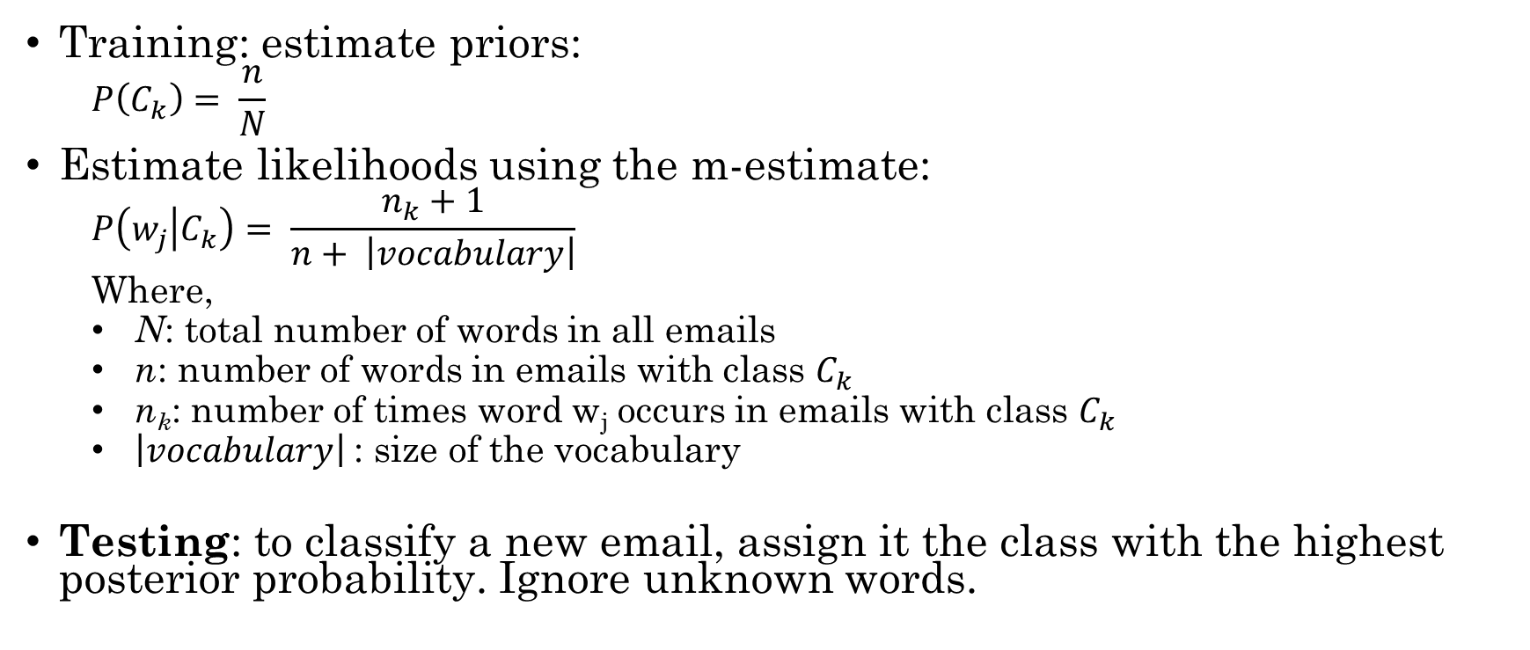
Practical example: Spam detection
Training: estimate priors:
  $$P\left(C_{k}\right)= \frac{n}{N}$$
Estimate likelihoods using the m-estimate:
  $$P\left(w_{j} | C_{k}\right)= \frac{n_{k}+1}{n+ \left|vocabulary\right|}$$
  Where,
  N: total number of words in all emails
  n: number of words in emails with class $C_{k}$
  n_{k}: number of times word w_{j} occurs in emails with class $C_{k}$
  $\left|vocabulary\right|$: size of the vocabulary
Testing: to classify a new email, assign it the class with the highest posterior probability. Ignore unknown words.

Slide 26
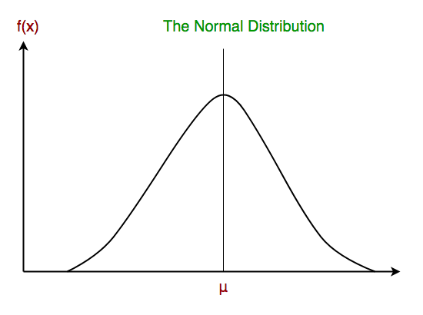
Gaussian Naïve Bayes
When dealing with continuous data, a typical assumption is that the continuous values associated with each class are distributed according to a normal (or Gaussian) distribution.
A Gaussian distribution is also called Normal distribution. When plotted, it gives a bell-shaped curve, which is symmetric about the mean of the feature values as shown here:

Slide 27
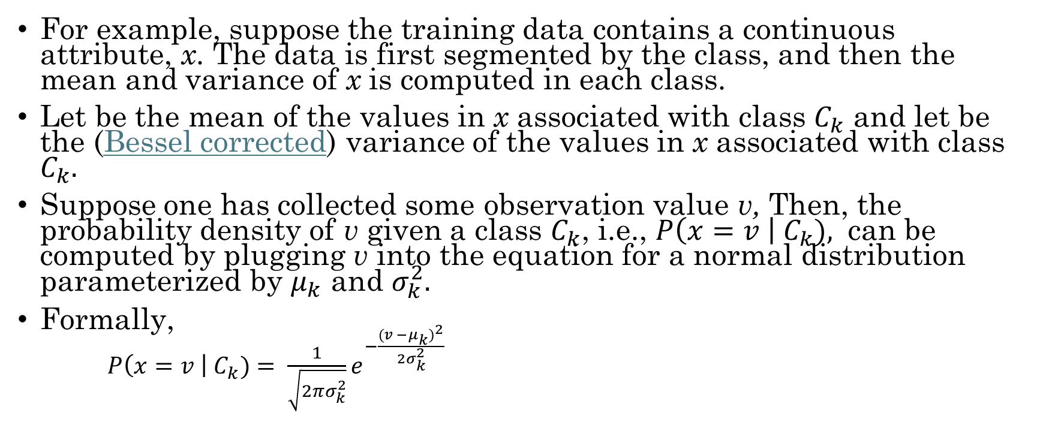
Gaussian Naïve Bayes
For example, suppose the training data contains a continuous attribute, x. The data is first segmented by the class, and then the mean and variance of x is computed in each class.
Let be the mean of the values in x associated with class $C_{k}$ and let be the (Bessel corrected) variance of the values in x associated with class $C_{k}.$
Suppose one has collected some observation value v, Then, the probability density of v given a class $C_{k}$, i.e., $P\left(x=v \right| C_{k}),$ can be computed by plugging v into the equation for a normal distribution parameterized by $μ_{k}$ and $σ_{k}^{2}.$
Formally,
  $P\left(x=v \right| C_{k})= \frac{1}{\sqrt{2πσ_{k}^{2}}}e^{−\frac{{(v −μ_{k})}^{2}}{2σ_{k}^{2}}}$

Slide 28
Naïve Bayes with continuous data
Another common technique for handling continuous values is to use binning to discretize the feature values and obtain a new set of Bernoulli-distributed features. Some literature suggests that this is required in order to use naive Bayes, but it is not true, as the discretization may throw away discriminative information.

Slide 29
Gaussian Naïve Bayes Example
Example problem: Person classification
  Problem: Classify whether a given person is a male or a female based on the measured features. The features include height, weight, and foot size. Although with NB classifier we treat them as independent, they are not in reality.

Slide 30
Gaussian Naïve Bayes Example
Example problem: Person classification
  Training: Example training set below:
Person | height (feet) | weight (lbs) | foot size (inches)
male | 6 | 180 | 12
male | 5.92 (5'11") | 190 | 11
male | 5.58 (5'7") | 170 | 12
male | 5.92 (5'11") | 165 | 10
female | 5 | 100 | 6
female | 5.5 (5'6") | 150 | 8
female | 5.42 (5'5") | 130 | 7
female | 5.75 (5'9") | 150 | 9

Slide 31
Gaussian Naïve Bayes Example (cont.)
The classifier created from the training set using a Gaussian distribution assumption would be (given variances are unbiased sample variances):
To create the classifier model, we assume equiprobable classes so that P(male) = P(female) = 0.5. This prior probability distribution might be based on prior knowledge of frequencies in the larger population or in the training set.
Person | mean (height) | variance (height) | mean (weight) | variance (weight) | mean (foot size) | variance (foot size)
male | 5.855 | 3.5033 × 10⁻² | 176.25 | 1.2292 × 10² | 11.25 | 9.1667 × 10⁻¹
female | 5.4175 | 9.7225 × 10⁻² | 132.5 | 5.5833 × 10² | 7.5 | 1.6667

Slide 32
Gaussian Naïve Bayes Example (cont.)
Testing
  Below is a sample to be classified as male or female:
Person | height (feet) | weight (lbs) | foot size (inches)
Sample (?) | 6 | 130 | 8

Slide 33
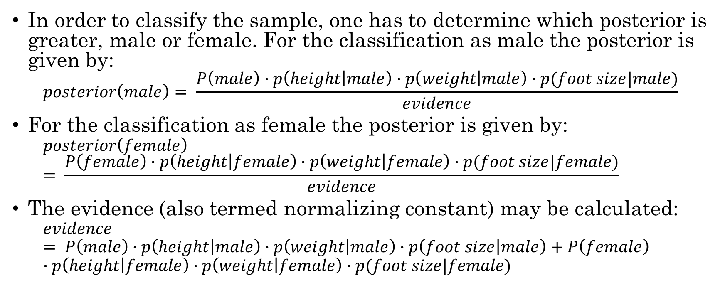
Gaussian Naïve Bayes Example (cont.)
In order to classify the sample, one has to determine which posterior is greater, male or female. For the classification as male the posterior is given by:
  $$posterior\left(male\right)= \frac{P\left(male\right)∙p\left(height | male\right)∙p\left(weight | male\right)∙p(foot size|male)}{evidence}$$
For the classification as female the posterior is given by:
  $$posterior\left(female\right)= \frac{P\left(female\right)∙p\left(height | female\right)∙p\left(weight | female\right)∙p(foot size|female)}{evidence}$$
The evidence (also termed normalizing constant) may be calculated:
  $$evidence= P\left(male\right)∙p\left(height | male\right)∙p\left(weight | male\right)∙p\left(foot size | male\right)+P\left(female\right)∙p\left(height | female\right)∙p\left(weight | female\right)∙p(foot size|female)$$

Slide 34
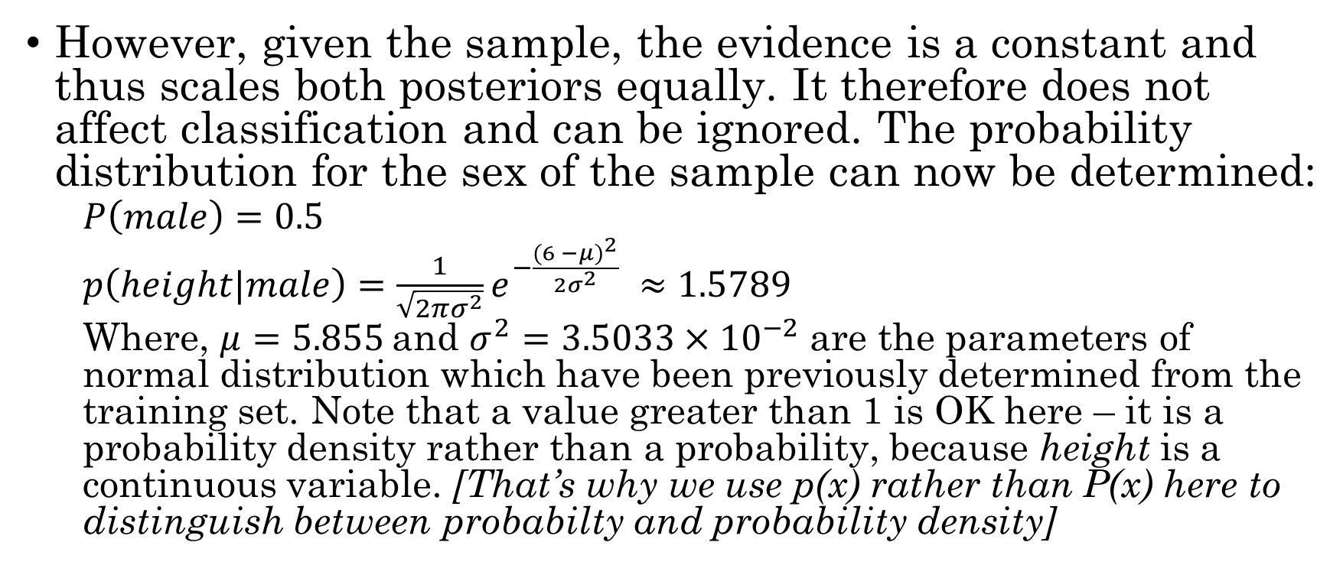
Gaussian Naïve Bayes Example (cont.)
However, given the sample, the evidence is a constant and thus scales both posteriors equally. It therefore does not affect classification and can be ignored. The probability distribution for the sex of the sample can now be determined:
  $$P\left(male\right)=0.5$$
  $p\left(height|male\right)=\frac{1}{\sqrt{2πσ^{2}}}e^{−\frac{{(6 −μ)}^{2}}{2σ^{2}}} ≈1.5789$
  Where, $μ=5.855$and $σ^{2}=3.5033×{10}^{−2}$ are the parameters of normal distribution which have been previously determined from the training set. Note that a value greater than 1 is OK here – it is a probability density rather than a probability, because height is a continuous variable. [That’s why we use p(x) rather than P(x) here to distinguish between probabilty and probability density]

Slide 35
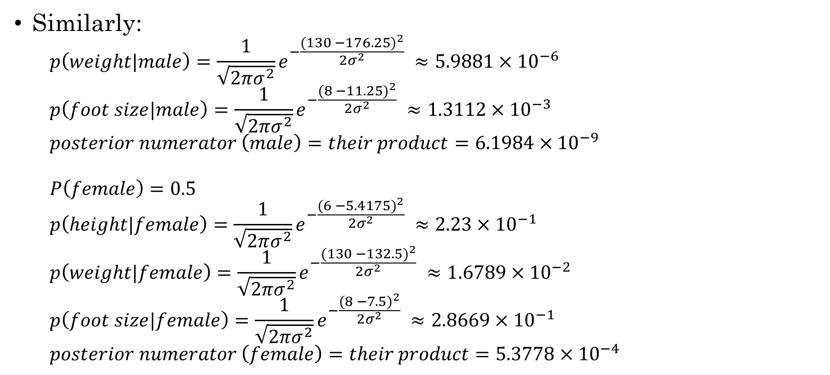
Gaussian Naïve Bayes Example (cont.)
Similarly:
  $$p\left(weight|male\right)=\frac{1}{\sqrt{2πσ^{2}}}e^{−\frac{{(130 −176.25)}^{2}}{2σ^{2}}} ≈5.9881×{10}^{−6}$$
  $$p\left(foot size|male\right)=\frac{1}{\sqrt{2πσ^{2}}}e^{−\frac{{(8 −11.25)}^{2}}{2σ^{2}}} ≈1.3112×{10}^{−3}$$
  $$posterior numerator \left(male\right)=their product=6.1984×{10}^{−9}$$
  $$P\left(female\right)=0.5$$
  $$p\left(height|female\right)=\frac{1}{\sqrt{2πσ^{2}}}e^{−\frac{{(6 −5.4175)}^{2}}{2σ^{2}}} ≈2.23×{10}^{−1}$$
  $$p\left(weight|female\right)=\frac{1}{\sqrt{2πσ^{2}}}e^{−\frac{{(130 −132.5)}^{2}}{2σ^{2}}} ≈1.6789×{10}^{−2}$$
  $$p\left(foot size|female\right)=\frac{1}{\sqrt{2πσ^{2}}}e^{−\frac{{(8 −7.5)}^{2}}{2σ^{2}}} ≈2.8669×{10}^{−1}$$
  $$posterior numerator \left(female\right)=their product=5.3778×{10}^{−4}$$

Slide 36
Gaussian Naïve Bayes Example (cont.)
Result:
  Since posterior numerator is greater in the female case, the prediction is that the sample is female.

Slide 37
Exercise
Apply Naïve Bayes classifier for document classification, i.e. Spam or not spam.

Slide 38
Thanks

